Slide 1
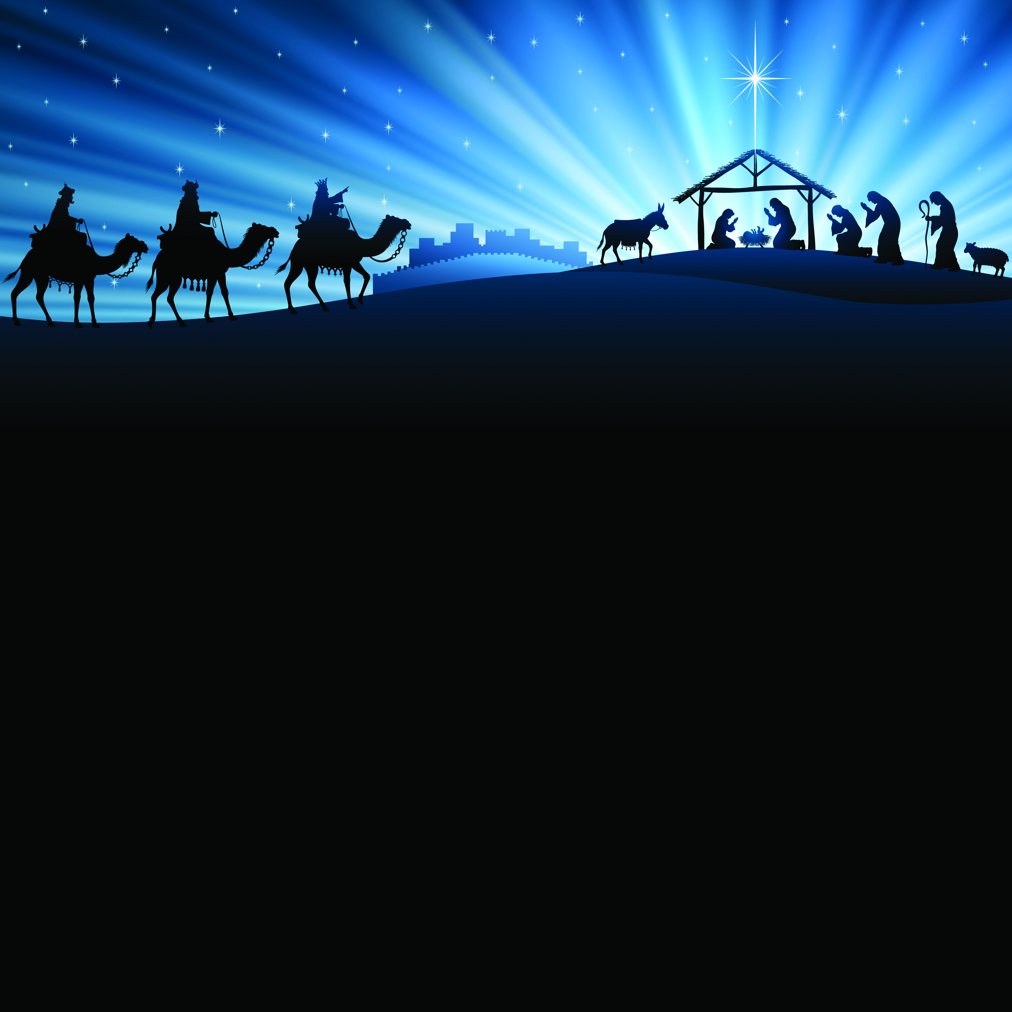
¹⁶ So they went with haste and found Mary and Joseph, and the child lying in the manger. ¹⁷ When they saw this, they made known what had been told them about this child; ¹⁸ and all who heard it were amazed at what the shepherds told them. ¹⁹ But Mary treasured all these words and pondered them in her heart. ²⁰ The shepherds returned, glorifying and praising God for all they had heard and seen, as it had been told them.
Luke 2: 16-20 (NRSV)

Slide 2
Scripture Lesson
Insert your passage here.

Slide 3
Insert song lyrics here.

Slide 4
Announcements
Insert announcements here.

