Slide 1
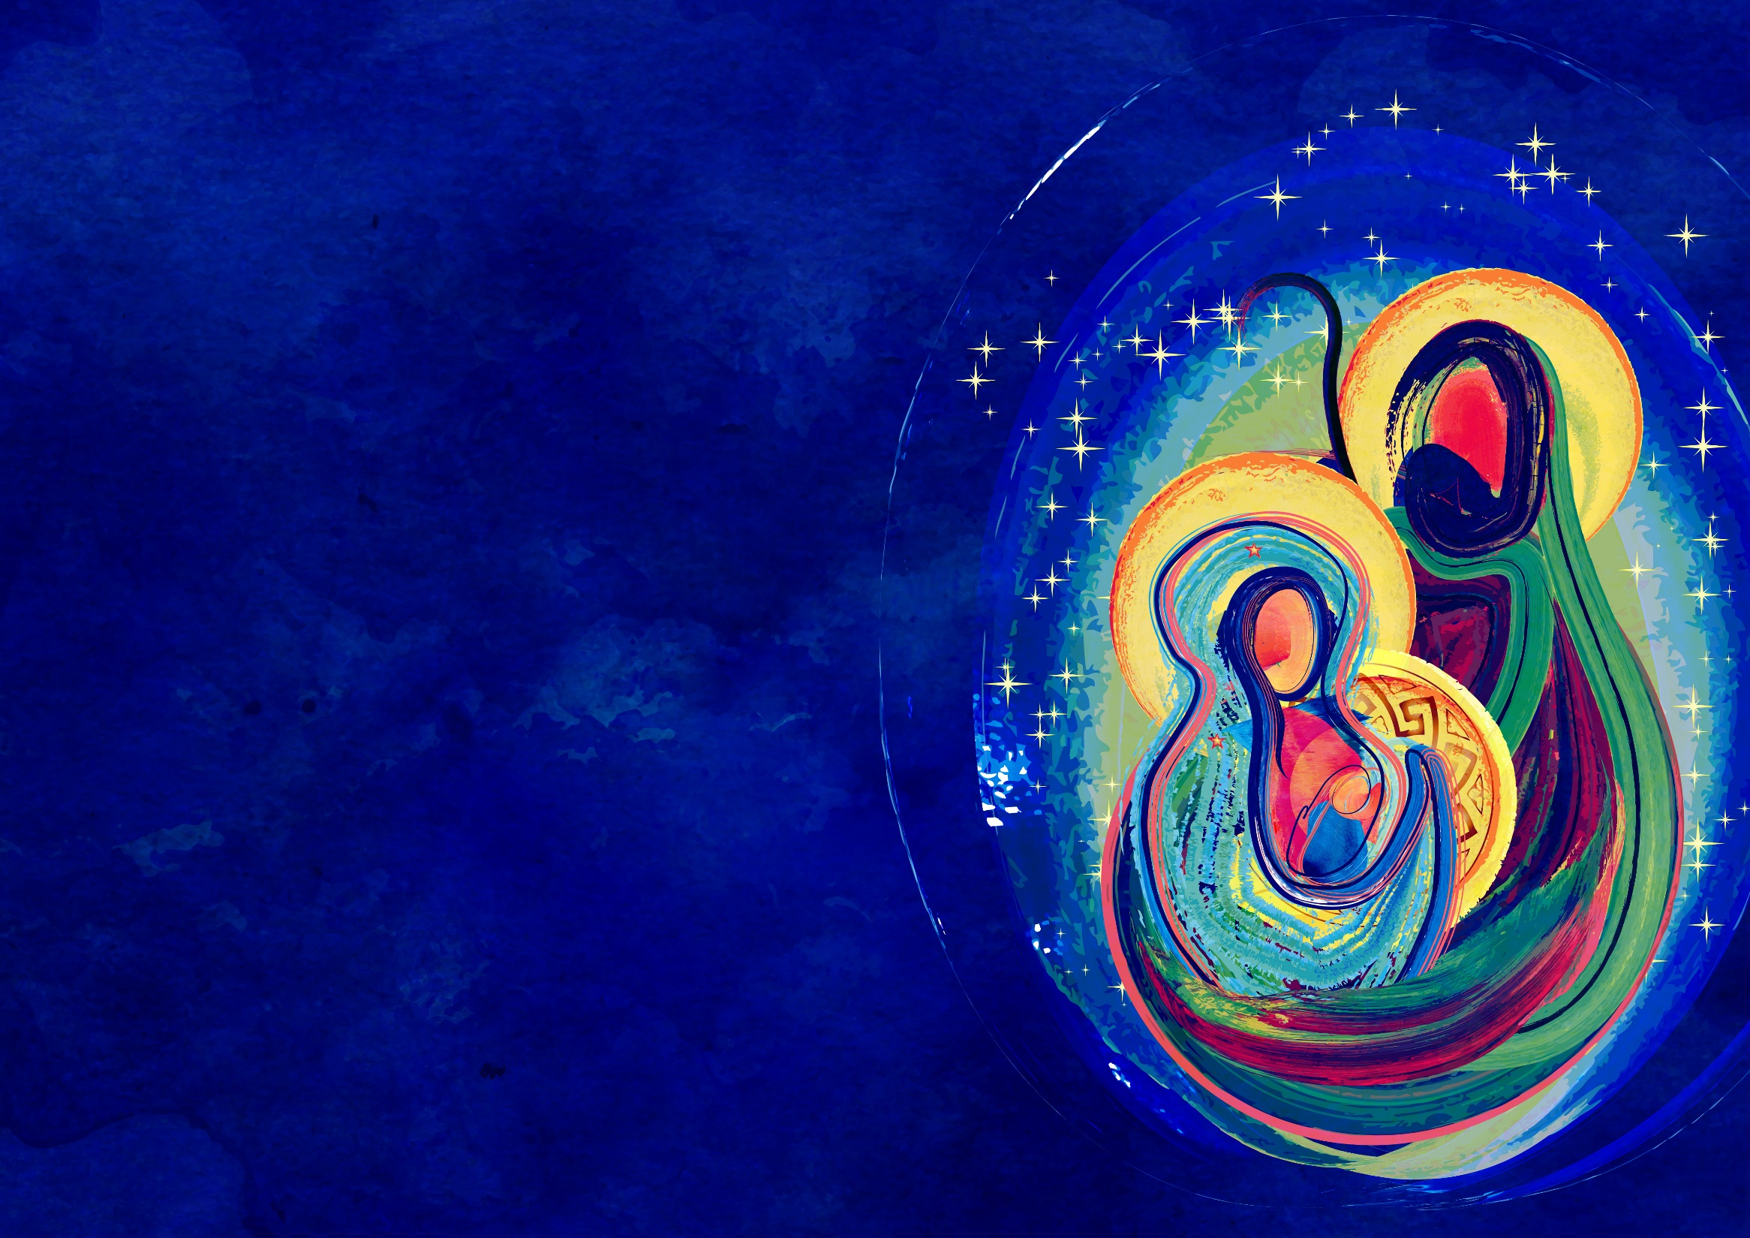
⁵ Joseph went to be registered with Mary, to whom he was engaged and who was expecting a child. ⁶ While they were there, the time came for her to deliver her child. ⁷ And she gave birth to her firstborn son and wrapped him in bands of cloth, and laid him in a manger, because there was no place for them in the inn.
Luke 2: 5-7 (NRSV)

Slide 2
Scripture Lesson
Insert your passage here.

Slide 3
Insert song lyrics here.

Slide 4
Announcements
Insert announcements here.

